Slide 1
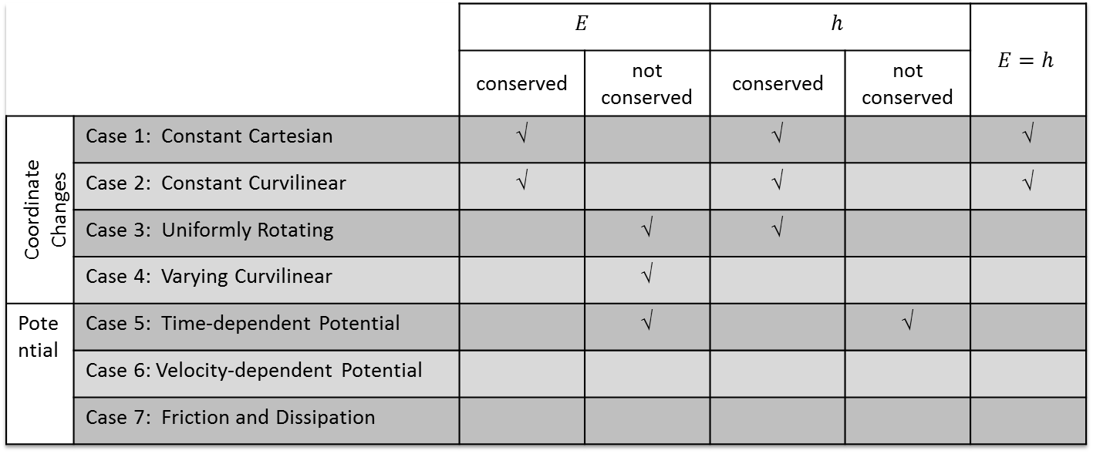
 |  | $$E$$ |  | $$h$$ |  | $$E=h$$
 |  | conserved | not conserved | conserved | not conserved
Coordinate Changes | Case 1: Constant Cartesian | √ |  | √ |  | √
 | Case 2: Constant Curvilinear | √ |  | √ |  | √
 | Case 3: Uniformly Rotating |  | √ | √
 | Case 4: Varying Curvilinear |  | √
Potential | Case 5: Time-dependent Potential |  | √ |  | √
 | Case 6: Velocity-dependent Potential
 | Case 7: Friction and Dissipation

